Slide 1

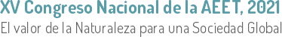

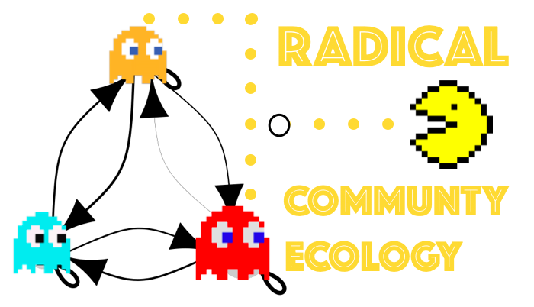


The balance between individual model complexity and the evaluation of species persistence
Lisa Buche, Ignasi Bartomeus & Oscar Godoy
lili_buche

Slide 2
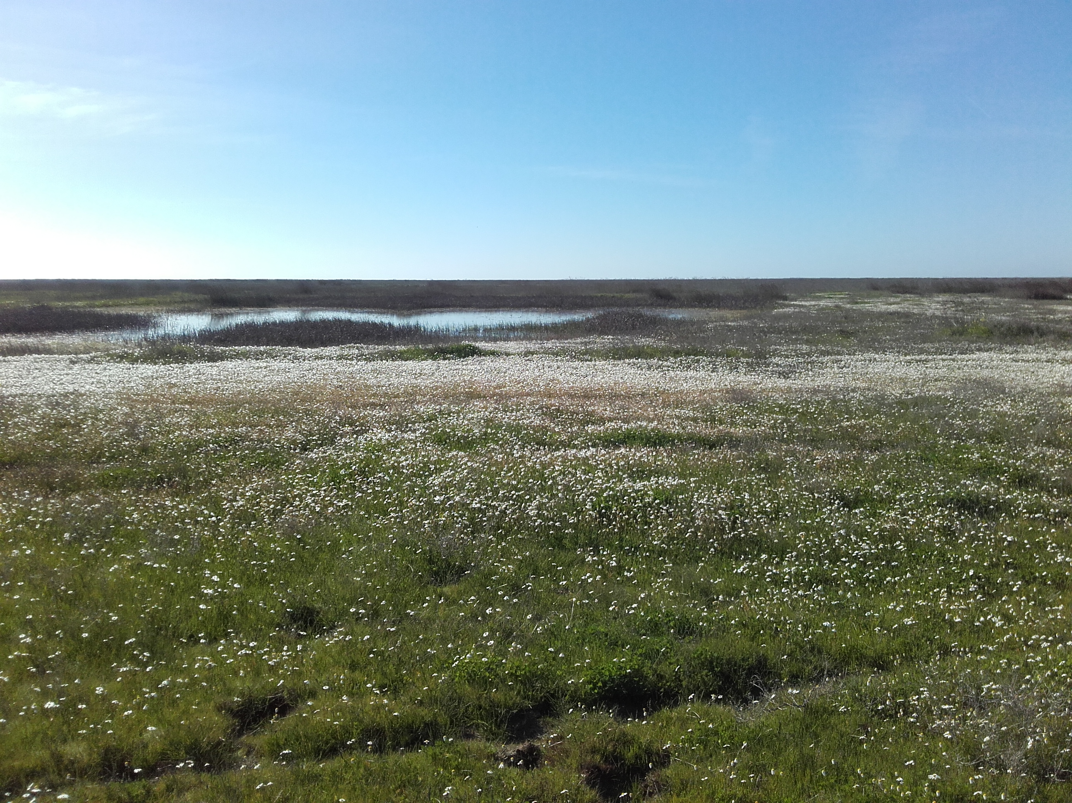
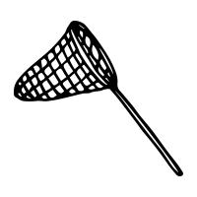
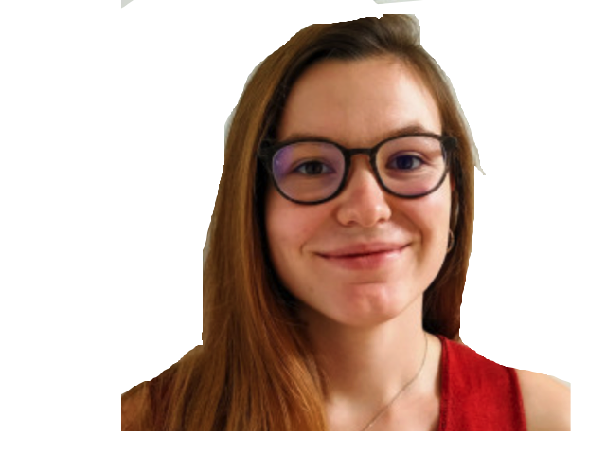
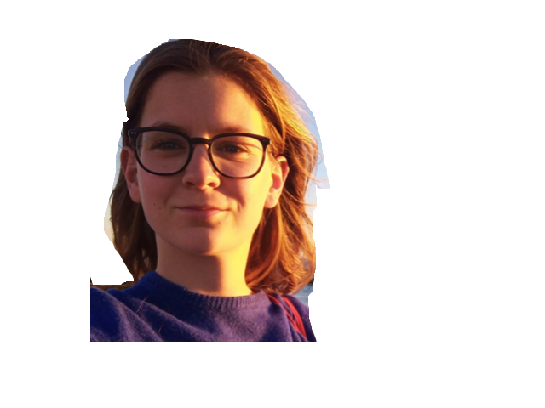


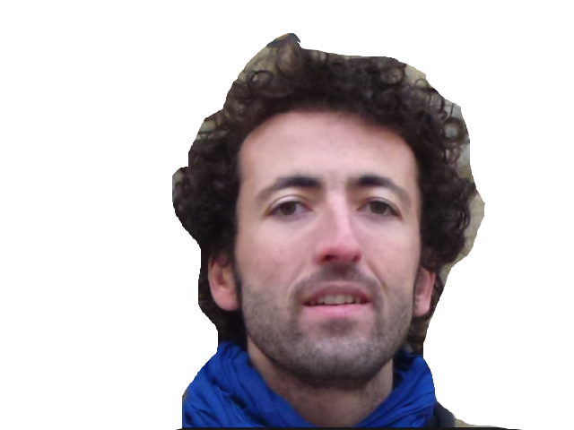
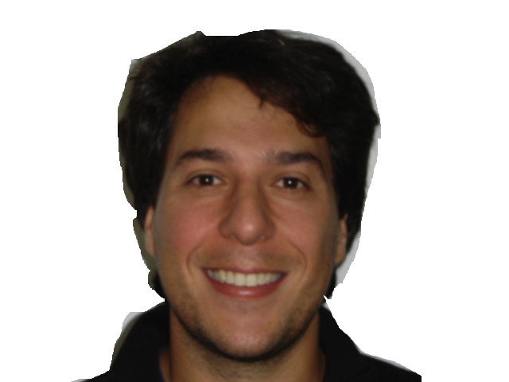



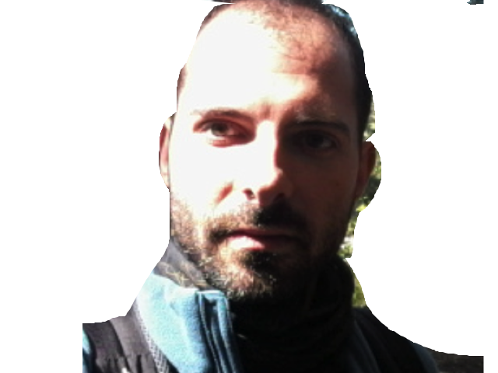



Slide 3









Slide 4


Understanding nature
Verbal hypothesis
How? When? For what?
1

Slide 5
Understanding nature
Verbal hypothesis
Collection of data
How? When? For what?
1

Slide 6
Understanding nature
Verbal hypothesis
Collection of data
How? When? For what?
Modelling: hypothesis to math
1

Slide 7
Understanding nature
Verbal hypothesis
Collection of data
How? When? For what?
Modelling: hypothesis to math
Explore
Inference
Prediction
Go beyond observations
1

Slide 8






From simple to complex models
First phenomenological equations with species interactions
$$\frac{dN_{1}}{dt}=r_{1}N_{1} −α_{11}N_{1}^{2} −α_{21}N_{1}N_{2}$$
$$\frac{dN_{2}}{dt}=r_{2}N_{2} −α_{22}N_{2}^{2} −α_{12}N_{2}N_{1}$$
$$a_{12}$$
N density
$α$ interaction
r intrinsic growth rate
1
2
$$a_{11}$$
$$a_{22}$$
$$a_{21}$$
Lotka 1926; Volterra 1926, 1928, 1931; Gause 1932; Gause and Witt 1935
2

Slide 9

From simple to complex models
First phenomenological equations with species interactions
$$\frac{dN_{1}}{dt}=r_{1}N_{1} −α_{11}N_{1}^{2} −α_{21}N_{1}N_{2}$$
$$\frac{dN_{2}}{dt}=r_{2}N_{2} −α_{22}N_{2}^{2} −α_{12}N_{2}N_{1}$$
$$a_{12}$$
N density
$α$ interaction
r intrinsic growth rate
1
2
$$a_{11}$$
$$a_{22}$$
$$a_{21}$$
Lotka 1926; Volterra 1926, 1928, 1931; Gause 1932; Gause and Witt 1935
Demographic variables $+Fecundity_{1}, Germination_{1},seed survival_{1}..$
Multispecies $+ N_{3},N_{4},..$
Climate variable(s)
$$+Temp, Precipitation,..$$
2

Slide 10

From simple to complex models
First phenomenological equations with species interactions
$$\frac{dN_{1}}{dt}=r_{1}N_{1} −α_{11}N_{1}^{2} −α_{21}N_{1}N_{2}$$
$$\frac{dN_{2}}{dt}=r_{2}N_{2} −α_{22}N_{2}^{2} −α_{12}N_{2}N_{1}$$
$$a_{12}$$
N density
$α$ interaction
r intrinsic growth rate
1
2
$$a_{11}$$
$$a_{22}$$
$$a_{21}$$
Lotka 1926; Volterra 1926, 1928, 1931; Gause 1932; Gause and Witt 1935
Demographic variables $+Fecundity_{1}, Germination_{1},seed survival_{1}..$
Multispecies $+ N_{3},N_{4},..$
Climate variable(s)
$$+Temp, Precipitation,..$$
Higher interactions $+ β_{123}N_{2}N_{3},…$
Trophic levels $+ {Herbivor}_{1},{Pollinator}_{1},Predator_{1}..$
Spatial scale $+coordonates,..$
Stochastic element $+ ε$
Functional traits $+ ∆trait_{1},…$
2

Slide 11
“﻿More realistically, the equations should include higher order terms and perhaps higher derivatives, the effects of seasonality and patchy environments, age distributions, time lags, and the like;”
MacArthur, 1970
3
Notes:
Increase realims
More confidence in the metrics drawn from the model --> ND and FD

Slide 12
“﻿More realistically, the equations should include higher order terms and perhaps higher derivatives, the effects of seasonality and patchy environments, age distributions, time lags, and the like;”
MacArthur, 1970
3
Notes:
Increase realims
More confidence in the metrics drawn from the model --> ND and FD

Slide 13
What levels of complexity, in the model and in the data, are necessary to capture natural patterns ?

Slide 14
What levels of complexity, in the model and in the data, are necessary to capture natural patterns ?
Specific complexity for specific species ?
More complexity for the disturbed year ?
Grouping factors help to balance complexity?

Slide 15
Balance between complexity and simplicity
What levels of complexity, in the model and in the data, are necessary to capture natural patterns ?
Specific complexity for specific species ?
More complexity for the disturbed year ?
Grouping factors help to balance complexity?

Slide 16
Balance between complexity and simplicity
Doñana National Park
Data story
What levels of complexity, in the model and in the data, are necessary to capture natural patterns ?
Specific complexity for specific species ?
More complexity for the disturbed year ?
Grouping factors help to balance complexity?

Slide 17



Data Story
Place
9 plots including 36 subplots of 1 m²
Time
2017 to 2019
Actors
25 annual plants
7.5 cm
4
Notes:
Abundance or density?

Slide 18
Data Story
Place
9 plots including 36 subplots of 1 m²
Time
2017 to 2019
Actors
25 annual plants
Place
9 plots including 36
subplots of 1 m²
Time
2017 to 2019
Actors
25 annual plants
Abundant or rare ( <1% of total abundance over 3 years)
Forb or Grass
Family classification
Species level
7.5 cm
Grouping
factors
4
Notes:
Abundance or density?

Slide 19

Data Story
Scene 1- Competition
Identity and number of neighbours: 2
Number of fruits : 2
Number of seeds per fruit
Place
9 plots including 36
subplots of 1 m²
Time
2017 to 2019
Actors
25 annual plants
Abundant or rare ( <1% of total abundance over 3 years)
Forb or Grass
Family classification
Species level
7.5 cm
Grouping
factors
4
Notes:
Abundance or density?

Slide 20
Data Story
Scene 1- Competition
Identity and number of neighbours: 2
Number of fruits : 2
Number of seeds per fruit
=> Intrinsic growth rate
Seed production over time
Plant interactions: pairwise and higher-order (HOIs)
Place
9 plots including 36 subplots of 1 m²
Time
2017 to 2019
Actors
25 annual plants
Place
9 plots including 36
subplots of 1 m²
Time
2017 to 2019
Actors
25 annual plants
Abundant or rare ( <1% of total abundance over 3 years)
Forb or Grass
Family classification
Species level
7.5 cm
Grouping
factors
4
Notes:
Abundance or density?

Slide 21

Data Story
Scene 1- Competition
Identity and number of neighbours: 2
Number of fruits : 2
Number of seeds per fruit
=> Intrinsic growth rate
Seed production over time
Plant interactions: pairwise and higher-order (HOIs)
Place
9 plots including 36 subplots of 1 m²
Time
2017 to 2019
Actors
25 annual plants
7.5 cm
HOIs : A third species changes the per capita effect of a competing species on a focal species
4
Notes:
Abundance or density?

Slide 22

From Data to model
Beverton-Holt model
$$Seed_{i}=\frac{intrinsic growth rate_{i}}{1+pairwise interactions }$$
$$﻿$$
﻿
6
Notes:
Equations ??

Slide 23

From Data to model
Beverton-Holt model
$$Seed_{i,y}=\frac{intrinsic growth rate_{i,y}}{1+pairwise interactions_{y}+ higher−order interactions_{y} }$$
$$﻿$$
﻿
Temporal scale
Spatial scale
Pairwise interactions
HOIs
6
Notes:
Equations ??

Slide 24

From Data to model
Beverton-Holt model
$$Seed_{i,y}=\frac{intrinsic growth rate_{i,y}}{1+pairwise interactions_{y}+ higher−order interactions_{y} }$$
$$﻿$$
﻿
$$F_{i,t+1}= \frac{λ_{i,year}}{1+\sum_{j=1}^{S}{α_{i,j,year}N_{j,t}+ \sum_{k=1}^{S}{\sum_{j=1}^{S}{β_{i,j,k,year}N_{j,t,year}N_{k,t,year}}}}}$$
﻿
Temporal scale
Spatial scale
Pairwise interactions
HOIs
6
Notes:
Equations ??

Slide 25
Balance between complexity and simplicity
Doñana National Park
Data story
What levels of complexity, in the model and in the data, are necessary to capture natural patterns ?
Specific complexity for specific species ?
More complexity for the disturbed year ?
Grouping factors help to balance complexity?
Modified Beverton-Holt model

Slide 26
Balance between complexity and simplicity
Doñana National Park
Data story
What levels of complexity, in the model and in the data, are necessary to capture natural patterns ?
Specific complexity for specific species ?
More complexity for the disturbed year ?
Grouping factors help to balance complexity?
Modified Beverton-Holt model
Bayesian statistics with sparsity approach and preliminary fit

Slide 27
A bayesian approach
Parameters are estimated as probability based on prior belief and the evidence
Associated uncertainty
Posterior Beliefs
Evidence
Prior Beliefs
Weiss-lehman & al, 2021
7
https://www.analyticsvidhya.com/blog/2016/06/bayesian-statistics-beginners-simple-english/

Slide 28

A sparsity approach: to choose or not to choose
﻿Identifying important species interactions
$$element_{i,year}= element_{0,i,year}+\hat{element_{i},j,year}$$
Species interaction coefficients as linear combinations of the average interaction strength and species-specific deviation
8
Weiss-lehman & al, 2021

Slide 29

A sparsity approach: to choose or not to choose
﻿Identifying important species interactions
$$element_{i,year}= element_{0,i,year}+\hat{element_{i},j,year}$$
Species interaction coefficients as linear combinations of the average interaction strength and species-specific deviation
$\hat{element}i,j,year$ ~ 0
8
Weiss-lehman & al, 2021

Slide 30

A sparsity approach: to choose or not to choose
﻿Identifying important species interactions
$$element_{i,year}= element_{0,i,year}+\hat{element_{i},j,year}$$
Species interaction coefficients as linear combinations of the average interaction strength and species-specific deviation
$\hat{element}i,j,year$ ~ 0
Alpha interspecific ${ \hat{α}}_{0,i,j,year}$
Beta interspecific ${ \hat{β}}_{0,i,j,k,year}$
Beta intraspecific ${ \hat{β}}_{0,i,i,i,year}$
8
Weiss-lehman & al, 2021

Slide 31

Preliminary fitting
Fit the full model with the regularized horseshoe priors to induce sparsity in the species-specific terms
$\hat{if element= }$species-specific interaction have a range $[\sim 0, \sim 0]$
=>$\hat{ element=0}$
9

Slide 32

Preliminary fitting
Fit the full model with the regularized horseshoe priors to induce sparsity in the species-specific terms
$\hat{if element= }$species-specific interaction have a range $[\sim 0, \sim 0]$
=>$\hat{ element=0}$
Fit a final model using traditional, non-sparse methods.
Bayesian approach + Sparsity approach + Preliminary fitting
➔ Balance between realism and tractability/ relevance
9

Slide 33
Balance between complexity and simplicity
Doñana National Park
Data story
What levels of complexity, in the model and in the data, are necessary to capture natural patterns ?
Specific complexity for specific species ?
More complexity for the disturbed year ?
Grouping factors help to balance complexity?
Modified Beverton-Holt model
Bayesian statistics with sparsity approach and preliminary fit

Slide 34
Balance between complexity and simplicity
Doñana National Park
Data story
What levels of complexity, in the model and in the data, are necessary to capture natural patterns ?
Specific complexity for specific species ?
More complexity for the disturbed year ?
Grouping factors help to balance complexity?
Modified Beverton-Holt model
Bayesian statistics with sparsity approach and preliminary fit
Explore the potential levels of complexity

Slide 35
Complexity levels
Plant Code | Abundant or rare Low complexity | Grass or Forb Low complexity | Family Medium complexity | Plant species High complexity
HOMA | Abundant | Grass | Poaceae | Hordeum marinum
LEMA | Abundant | Forb | Asteraceae | Leontodon maroccanus
CHFU | Abundant | Forb | Asteraceae | Chamaemelum fuscatum
MESU | Rare | Forb | Fabaceae | Melilotus sulcatus
 | 8 abundant / 17 rare | 4 grasses / 21 forbs | 13 families | 25 species
10

Slide 36
Specific complexity for specific species
Beta intra-
Alpha inter-
Beta inter-
11
Notes:
CHFU 14 inter beta
Beta intra
CHFU and MESU 2 years

Slide 37
Specific complexity for specific species
Beta intra-
Alpha inter-
Species required different complexities in the model for different interactions
Beta inter-
11
Notes:
CHFU 14 inter beta
Beta intra
CHFU and MESU 2 years

Slide 38
Specific complexity for specific species
Class
Species
Family
Abundance
12

Slide 39
Specific complexity for specific species
Species required different complexities in their grouping factors
HOMA needs higher complexity
Class
Species
Family
Abundance
12

Slide 40
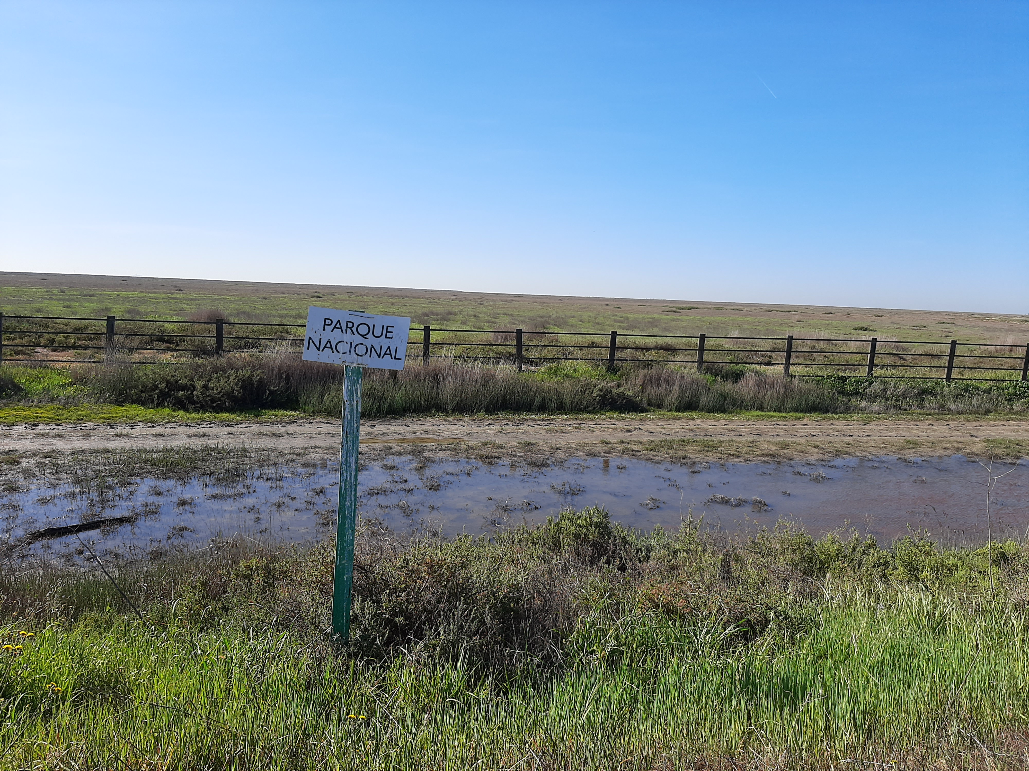
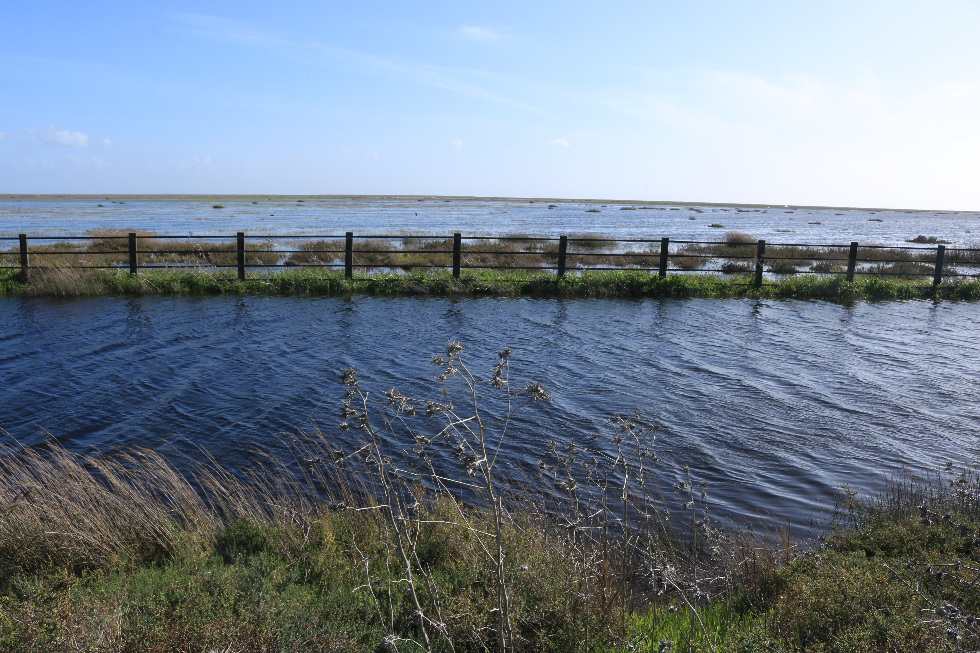
Specific complexity for specific years
2017
2018
13

Slide 41
Specific complexity for specific years
Disturbed years decrease the complexity of the model
2017
2018
Alpha inter-
Beta intra-
Beta inter-
13

Slide 42
Grouping factors help to balance complexity
Beta intra-
Alpha inter-
Beta inter-
15
Low
Medium
High

Slide 43
Grouping factors help to balance complexity
Beta intra-
Increase complexity in grouping factor, do not increase the relative complexity of the model
Alpha inter-
Beta inter-
15
Low
Medium
High

Slide 44
Specific complexity for who and when?
Complexity in the data and in the model depends on
Focal species
Year
16

Slide 45
Specific complexity for who and when?
Complexity in the data and in the model depends on
Focal species
Year
Complexity in the model can be balanced by including less complexity in the grouping levels
16

Slide 46
Specific complexity for who and when?
Complexity in the data and in the model depends on
Focal species
Year
Complexity in the model can be balanced by including less complexity in the grouping levels
WORK IN PROGRESS
16

Slide 47
Balance between complexity and simplicity
Doñana National Park
Data story
What levels of complexity, in the model and in the data, are necessary to capture natural patterns ?
Specific complexity for specific species ?
More complexity for the disturbed year ?
Grouping factors help to balance complexity?
Modified Beverton-Holt model
Bayesian statistics with sparsity approach and preliminary fit
Explore the potential levels of complexity
Infer the distributions of relevant interactions
Predict community composition and abundance

Slide 48
Balance between complexity and simplicity
Doñana National Park
Data story
What levels of complexity, in the model and in the data, are necessary to capture natural patterns ?
Specific complexity for specific species ?
More complexity for the disturbed year ?
Grouping factors help to balance complexity?
Modified Beverton-Holt model
Bayesian statistics with sparsity approach and preliminary fit
Explore the potential levels of complexity
Infer the distributions of relevant interactions
Predict community composition and abundance

Slide 49





Let’s get complexe
Place
9 plots including 36 subplots of 1 m²
Time
2015 to 2021
Actors
25 annual plant
44 species of herbivore
66 species of pollinator
32 species of pollinator/ herbivore : beetles
Ex. Bee → Andrena sp. -> Andrena humilis
7.5 cm
Addition of environmental variables ( e.g. precipitation)
$$﻿ln\left(α_{i,j}\right)=a_{0,i,year}{ +\hat{a}}_{0,i,j,year}+{(a}_{0,e,i,year}{ +\hat{a}}_{0,e,i,j,year}) X_{E}$$
17
Notes:
Abundance or density?

Slide 50
Thank you !
@lili_buche
Take Home message
Do not be scared of complexity !

Slide 51
 | species | family | code.plant | class | Native.sp | rareORabundant
1 | Beta macrocarpa | Amaranthaceae | BEMA | Forb | Native Annual Forb | rare
2 | Chamaemelum fuscatum | Asteraceae | CHFU | Forb | Native Annual Forb | abundant
3 | Chamaemelum mixtum | Asteraceae | CHMI | Forb | Native Annual Forb | rare
4 | Centaurium tenuiflorum | Gentianaceae | CETE | Forb | Native Annual Forb | abundant
5 | Coronopus squamatus | Brassicaceae | COSQ | Forb | Native Annual Forb | rare
6 | Frankenia pulverulenta | Frankeniaceae | FRPU | Forb | Native Annual Forb | rare
7 | Hordeum marinum | Poaceae | HOMA | Grass | Native Annual Grass | abundant
8 | Leontodon maroccanus | Asteraceae | LEMA | Forb | Native Annual Forb | abundant
9 | Lythrum tribracteatum | Lythraceae | LYTR | Forb | Native Annual Forb | rare
10 | Melilotus elengans | Fabaceae | MEEL | Forb | Native Annual Forb | rare
11 | Melilotus sulcatus | Fabaceae | MESU | Forb | Native Annual Forb | rare
12 | Plantago coronopus | Plantaginaceae | PLCO | Forb | Native Annual Forb | rare
13 | Polypogon monspeliensis | Poaceae | POMO | Grass | Native Annual Grass | rare
14 | Polypogon martinus | Poaceae | POMA | Grass | Native Annual Grass | abundant
15 | Pulicaria paludosa | Asteraceae | PUPA | Forb | Native Annual Forb | abundant
16 | Parapholis incurva | Poaceae | PAIN | Grass | Native Annual Grass | abundant
17 | Salsola soda | Amaranthaceae | SASO | Forb | Native Annual Forb | abundant
18 | Scorzonera laciniata | Asteraceae | SCLA | Forb | Native Annual Forb | rare
19 | Spergularia rubra | Caryophyllaceae | SPRU | Forb | Native Annual Forb | rare
20 | Sonchus asper | Asteraceae | SOAS | Forb | Native Annual Forb | rare
21 | Suaeda splendens | Amaranthaceae | SUSP | Forb | Native Annual Forb | rare
22 | Ranunculus peltatus | Ranunculuc | RAPE | Forb | Native Annual Forb | rare
23 | Achicoria sp | Asteraceae | ACHI | Forb | NA | rare
24 | Anagallis arvensis | Primulacea | ANAR | Forb | NA | rare
25 | NA | Fabaceae | MEPO | Forb | NA | rare
 |  |  |  | 4 Grass/ 21 Forb |  | 8 abundant/ 17 rare

Slide 52
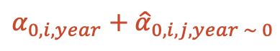

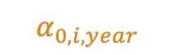



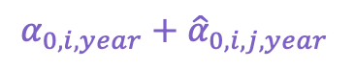
A sparsity approach: to chose or not to chose
﻿Identifying important species interactions
$$﻿ln\left(α_{i,i,year}\right)=a_{0,i,year}$$
$ln\left(α_{i,j,year}\right)=α_{0,i,year}{ +\hat{α}}_{0,i,j,year}$
$$element_{0}=generic element$$
$\hat{element= }$species-specific deviation
$$﻿ln\left(β_{i,j,k,year}\right)=β_{0,i,year}{ +\hat{β}}_{0,i,j,k,year}$$
$$α_{0,i,year}$$
$${α_{0,i,year}+\hat{α}}_{0,i,j,year }$$
Species interaction coefficients as linear combinations of the average interaction strength and species-specific deviation
Alpha interspecific ${ \hat{α}}_{0,i,j,year}$
Beta interspecific ${ \hat{β}}_{0,i,j,k,year}$
Beta intraspecific ${ \hat{β}}_{0,i,i,i,year}$
$${α_{0,i,year}+\hat{α}}_{0,i,j,year \sim 0}$$
8
Weiss-lehman & al, 2021

Slide 53
Low complexity - class
Focal code | Grass or Forb
MESU | Forb
LEMA | Forb
HOMA | Grass
CHFU | Forb
HOIs
HOIs
10

Slide 54
Low complexity – abundance
Focal code | Abundant or rare
MESU | Abundant
LEMA | Abundant
HOMA | Abundant
CHFU | Rare
HOIs
HOIs
11

Slide 55
Medium complexity - Family
Focal code | Family
MESU | Poaceae
LEMA | Asteraceae
HOMA | Asteraceae
CHFU | Fabaceae
HOIs
HOIs
12

Slide 56
High complexity -Species
Focal code | Plant species
MESU | Hordeum marinum
LEMA | Leontodon maroccanus
HOMA | Chamaemelum fuscatum
CHFU | Melilotus sulcatus
HOIs
HOIs
13

